Slide 1



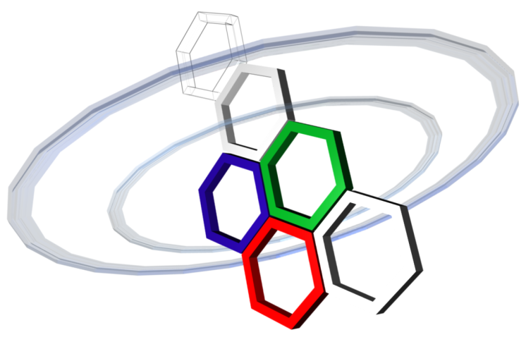
Spatial Data Focusing:
An alternative to Beamforming for geocasting scenarios
Sidney Golstein, Michael Odhiambo
Philippe De Doncker, François Horlin, Julien Sarrazin
GEOHYPE project
ANR funding - JCJC program

Slide 2
GEOcasting for HYPEr resolution spatial data focusing
Goal: Wireless broadcasting of geolocalized data
Applications:
Interactive contents in museums
Danger areas indication for visual impaired persons (zebra crossings…)
Alert people within an area of sudden emergency
GEOHYPE system does not know users location
User privacy is respected
Lighter infrastructure
Ideal for indoor environments

Slide 3


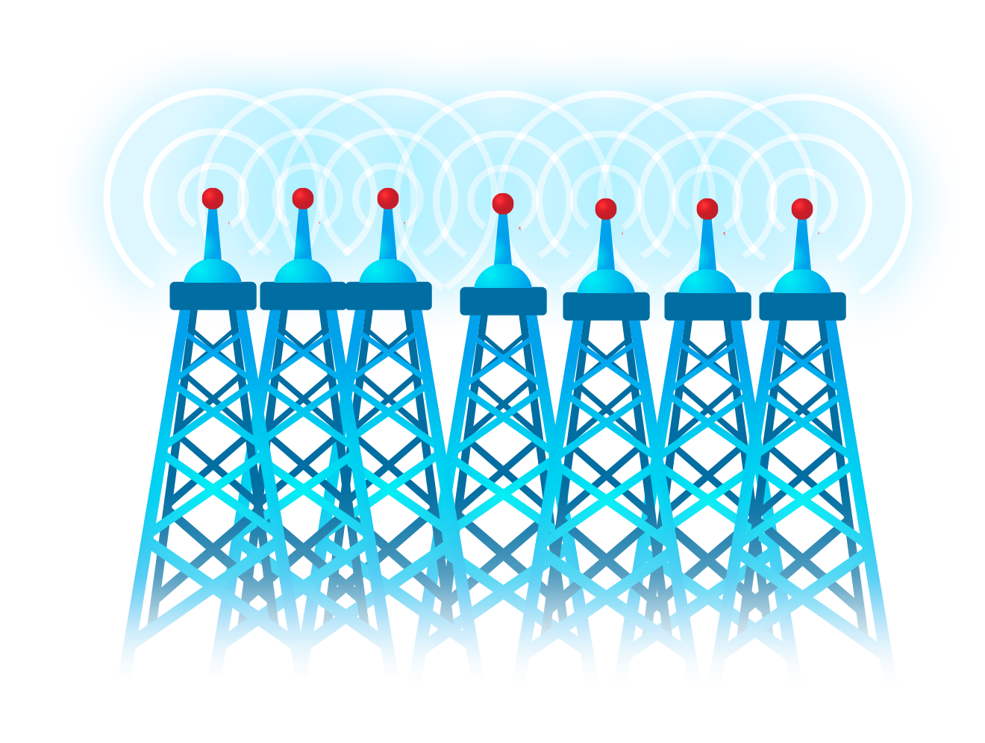


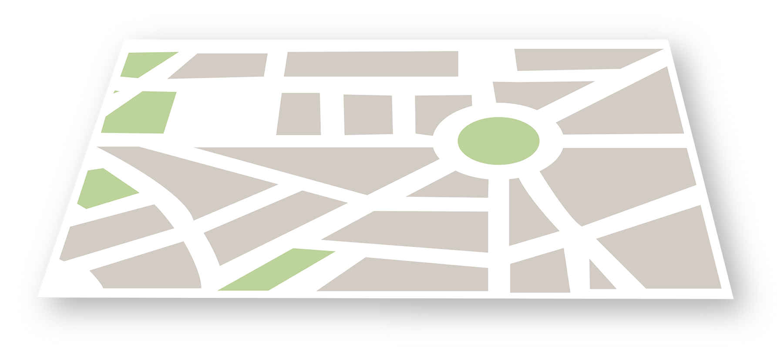
Phased array: power focusing
Broadcasting
The data is being send to the location, whether a user is there or not
Power focusing
Physical limitation: beamwidth is related to aperture size of the array
Huge array needed to obtain narrow beam-width

Slide 4
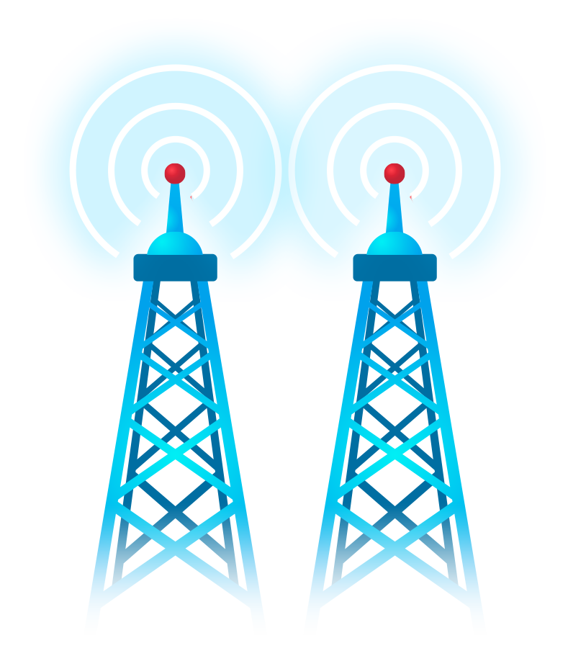
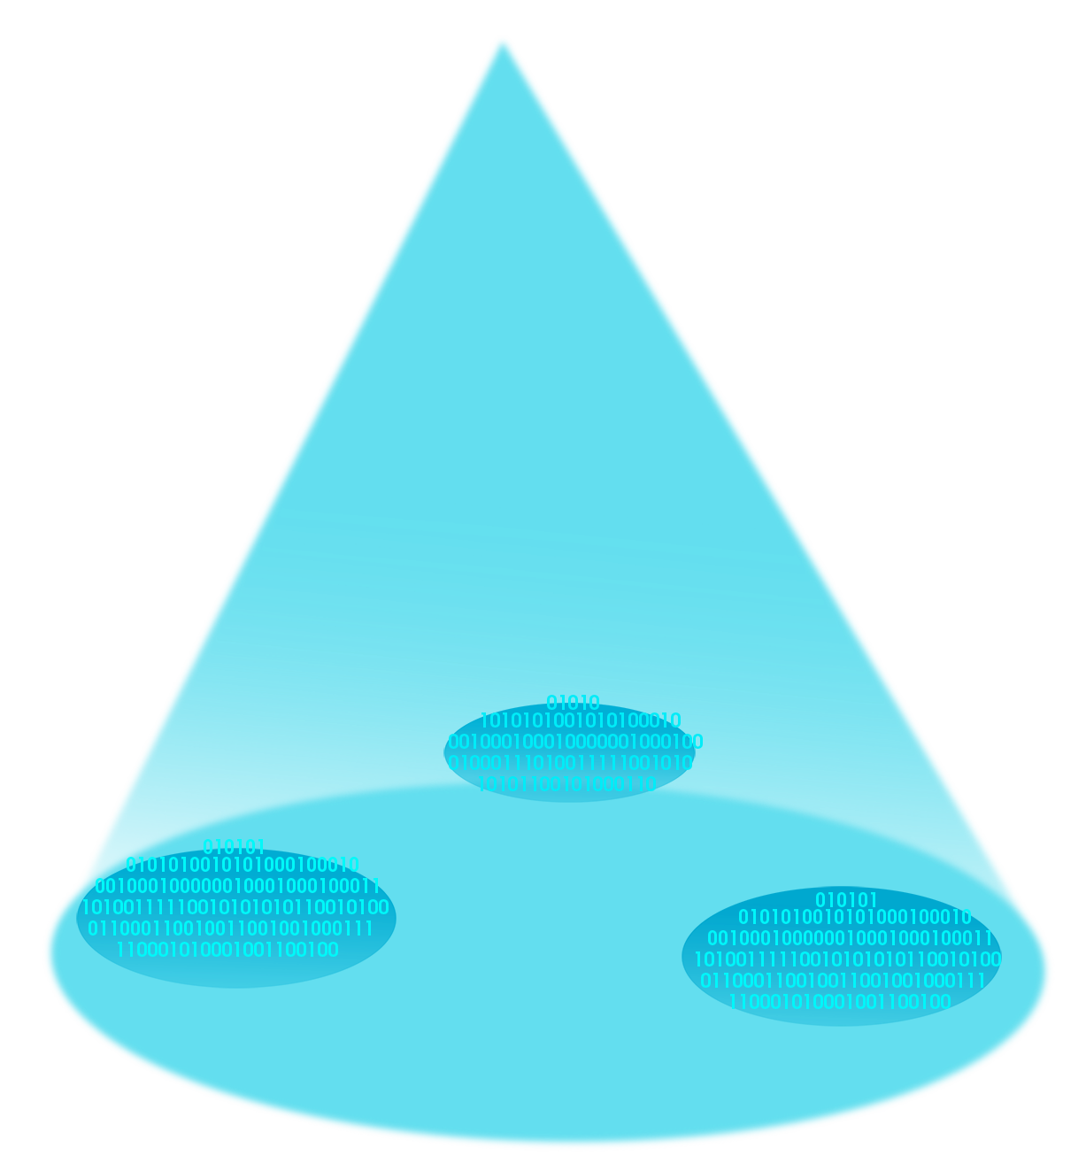
Spatial Data Focusing instead of power focusing

Slide 5
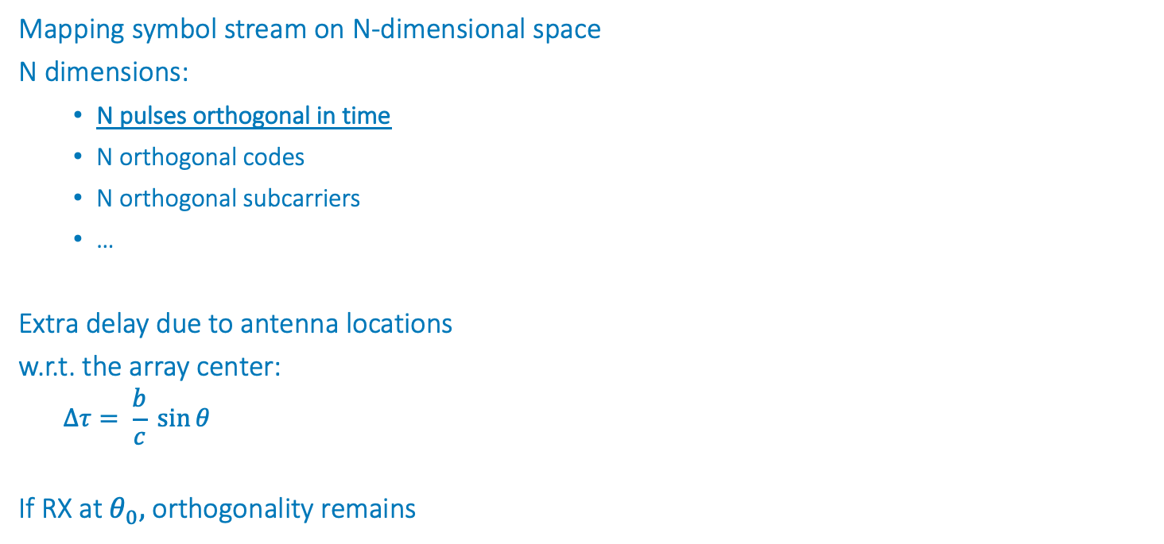
Spatial Data Focusing
Mapping symbol stream on N-dimensional space
N dimensions:
N pulses orthogonal in time
N orthogonal codes
N orthogonal subcarriers
…
Extra delay due to antenna locations
w.r.t. the array center:
$$∆τ= \frac{b}{c} \sin{θ}$$
If RX at $θ_{0},$ orthogonality remains
b

Slide 6
Spatial Data Focusing
Spatial Data Focusing using Time Resources
- Simulations -

Slide 7
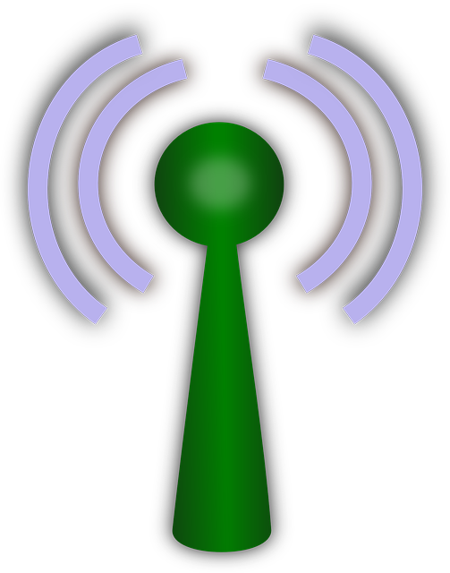
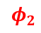
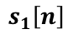
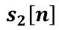
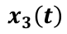
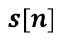
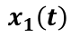
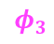
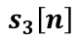
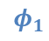
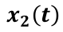
Spatial Data Focusing: principle of time orthogonality
Φ₂
3TX, 3 dimensions
Φ₁
Front-End
Front-End
Front-End
N PAM modulations
1 per antenna
Φ₃
$$x_{1}\left(t\right)$$
$$x_{2}\left(t\right)$$
$$x_{3}\left(t\right)$$
$$φ_{1}$$
*
$$φ_{2}$$
*
$$φ_{3}$$
*
$$s_{1}\left[n\right]$$
$$s_{2}\left[n\right]$$
$$s_{3}\left[n\right]$$
3-dimension mapping
$$s[n]$$

Slide 8
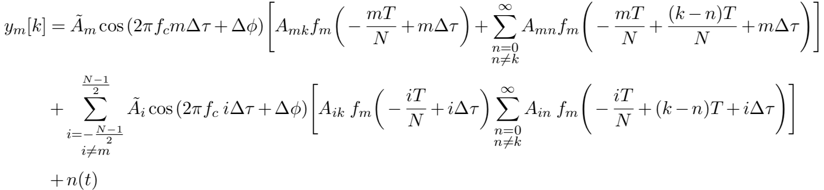
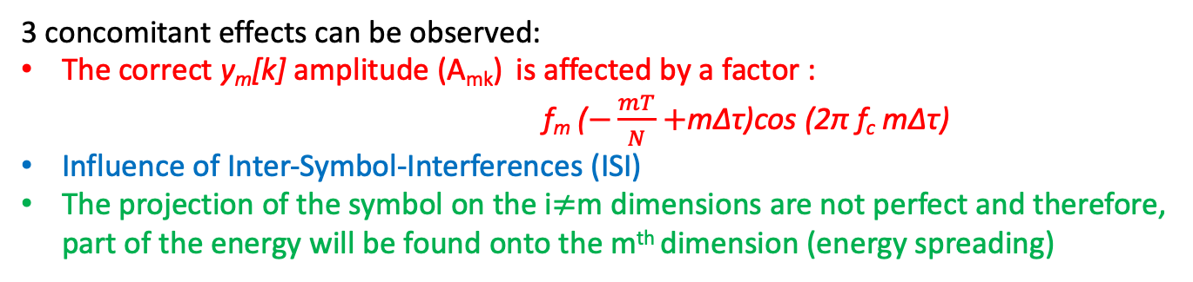
Spatial Data Focusing
Example of Spatial Data Focusing: N antennas N Dimension, Time scenario
Received k^{th} estimated symbol (projection on dimension n):
3 concomitant effects can be observed:
The correct y_{m}[k] amplitude (A_{mk}) is affected by a factor :
f_{m} ($−\frac{mT}{N}+$mΔτ)cos (2π f_{c} mΔτ)
Influence of Inter-Symbol-Interferences (ISI)
The projection of the symbol on the i$≠$m dimensions are not perfect and therefore, part of the energy will be found onto the m^{th} dimension (energy spreading)
Notes:
Faire une slide en mode si perfect situation (broadside, perfect synchro,…)

Slide 9
Spatial Data Focusing
BER results: comparison between power and data focusing
Beamwidth @ BER = 10⁻³
BF using 16QAM:
Δθ = 51° (N = 2)
Δθ = 31° (N = 3)
SDF:
Δθ = 24° (N = 2)
Δθ = 12.5°(N = 3)
2 observations:
Sidelobes suppressed
Narrower beamwidth
f = 2.4 GHz, f_{d} = 20 MHz, b = 0.8 λ, M = 16 for N = 2, M = 64 for N= 3 (perfect synchronization)

Slide 10
Spatial Data Focusing
Spatial Data Focusing using IQ resources
- Simulations -

Slide 11


Spatial Data Focusing
Example of Spatial Data Focusing: 2D IQ scenario
MISO configuration:
- Dual-antenna @ TX
- Single antenna @ RX
θ=16°
θ=4°
Q
$$x_{1}\left(t\right)=x_{I}\left(t\right)$$
θ=0°
I
$$x_{2}\left(t\right)=x_{Q}\left(t\right)$$

Slide 12
Spatial Data Focusing
Example of Spatial Data Focusing: 2D IQ scenario
Received k^{th} estimated symbol (I projection only):
Q
I
3 concomitant effects can be observed:
The correct y_{I}[k] amplitude (I_{k}) is affected by a factor f(Δτ/2)cos π f_{c} Δτ
Influence of Inter-Symbol-Interferences (ISI)
The projection of the symbol on the Q dimension is not perfect and therefore, part of the energy will be found onto the I dimension (energy spreading)

Slide 13
Spatial Data Focusing: 2D IQ scenario
Focusing effect: BER = f(θ)
Beamwidth @ BER = 10⁻³
BF:
Δθ = 51°
SDF:
Δθ = 6.3°
2 observations:
Sidelobes suppressed
Narrower beamwidth
16-QAM, f = 2.4 GHz, f_{d} = 20 MHz, b = 0.8 λ, SNR = 20 dB (perfect synchronization)

Slide 14
Spatial Data Focusing
Spatial Data Focusing using IQ + Time resources
- Simulations -

Slide 15
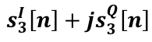
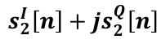
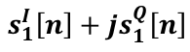
Spatial Data Focusing
Use time resources:
N orthogonal pulses
Use IQ resources:
2N dimensions
N antennas and 2N dimensions
Front-End
Front-End
Front-End
N QAM modulations
1 per antenna
$$x_{1}\left(t\right)$$
$$x_{2}\left(t\right)$$
$$x_{3}\left(t\right)$$
$$φ_{1}$$
*
$$φ_{2}$$
*
$$φ_{3}$$
*
$$s_{1}^{I}\left[n\right]+js_{1}^{Q}\left[n\right]$$
$$s_{2}^{I}\left[n\right]+js_{2}^{Q}\left[n\right]$$
$$s_{3}^{I}\left[n\right]+js_{3}^{Q}\left[n\right]$$
6-dimension mapping
$$s[n]$$

Slide 16
Spatial Data Focusing
BER results: comparison between power and data focusing (with channel estimation)
N = 2 antennas - 4 dimensions (I₁+jQ₁ & I₂+jQ₂)
N = 3 antennas - 6 dimensions (I₁+jQ₁ & I₂+jQ₂ & I₃+jQ₃)
Beamwidth @ BER = 10⁻³
BF:
Δθ = 51°(N = 2)
Δθ = 31°(N = 3)
SDF:
Δθ = 3.3°(N = 2)
Δθ = 1.8°(N = 3)
2 observations:
Sidelobes suppressed
Narrower beamwidths
Notes:
SNR = 20dB
Channel assumed constant during the frame

Slide 17
Spatial Data Focusing
Example of a
2 antennas - 4D scenario
- Measurements -

Slide 18
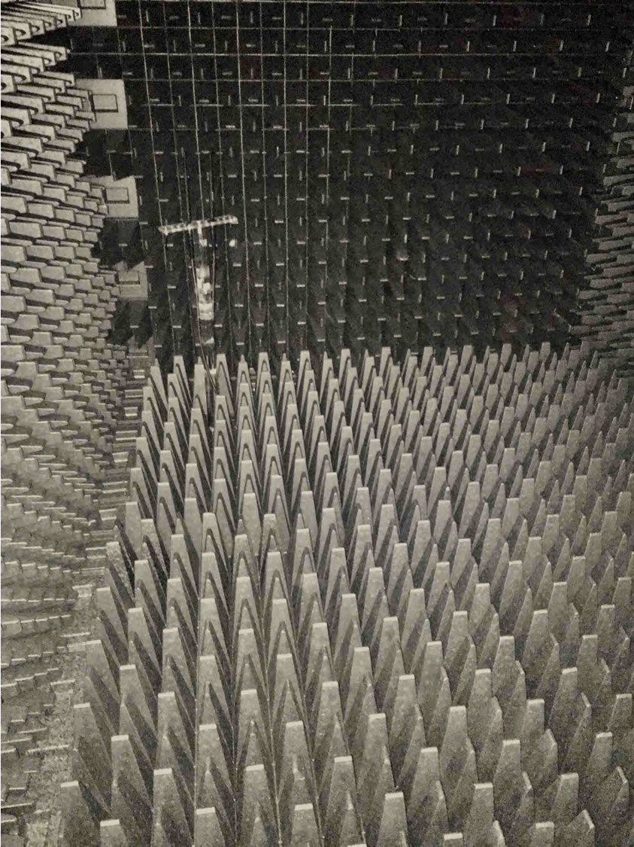
Spatial Data Focusing
Measurement Setup
AWG (2 x 12 GSa/s)
Scope (40 GSa/s)

Slide 19
Spatial Data Focusing
Measurement Results
N = 2 antennas - 4 dimensions (I₁+jQ₁ & I₂+jQ₂)
Parameters
f_{c} = 2.67 GHz
b = 0.8 λ
f_{d} = 20 MHz
Beamwidth @ BER = 10⁻³
SDF:
Δθ = 17.4° (M = 16)
Δθ = 4.1° (M = 256)
Noise robustness equivalence
M = 16 ⬄ QPSK
M = 256 ⬄ 16QAM
1D = 1 bit
1D = 2 bits

Slide 20
Spatial Data Focusing
Channel consideration
4 antennas - 8D scenario
- Measurements -

Slide 21
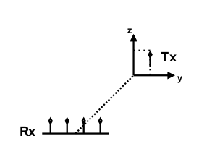
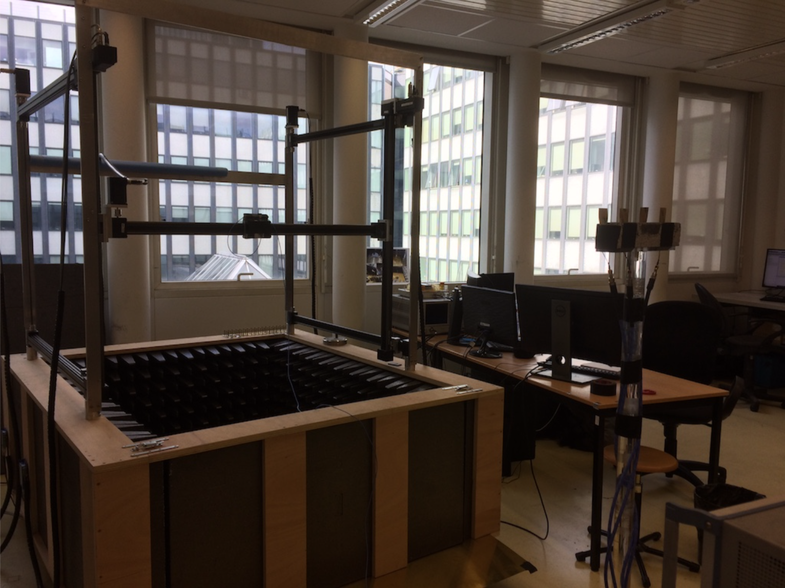
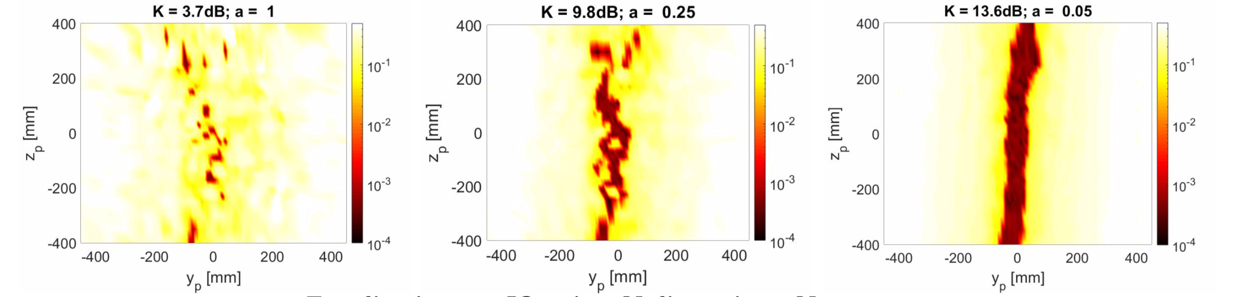
Spatial Data Focusing: 2D focusing
Setup:
4 antennas @ TX
IQ pair per antenna
2D scan:
BER = f(y,z), f_{c} = 3.5GHz
Notes:
Did experiments in indoor environments w/ 4 antenna array → Send IQ pair per antenna. Use of a 2D scan in the yz plane. Calibration such that at broadside, phase of each antenna channels is 0 and amplitude is equal
Equalizatiuon: Gain individually for each IQ pair based on TX and RX preamble; Phase: calculating the complex transfer function of the first
antenna, based on the preamble symbols
Measured channel → fast fading
Different K factor: time gating the impulse response with different Hann windows in order to play manually with the LOS component of the received signal
When high K factor (LOS component >> NLOS) → satisfying ber at broadside

Slide 22
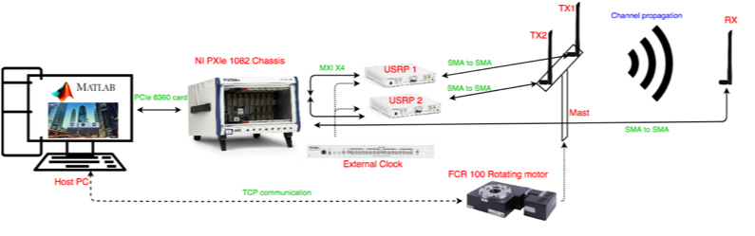
Spatial data focusing (SDF)
On-going
Orthogonal-code-based N-dimensions SDF
Orthogonal-frequency-based N-dimensions SDF
Channel assessment
More antennas:
Perspectives
Channel estimation and equalization
Position – based data focusing
Carrier recovery
N-Dimension dedicated mapping
Protocol aspects
Looking for collaborations
Notes:
Carrier recovery: phase of 2piw_ct
Protocol : for a real time demonstrator for example

Slide 23
Channel EQ
θ = -32°
N = 2 antennas, 4 dimensions using orthogonal pulses and IQ resources
I₁Q₁
I₂Q₂
I₁I₂
Q₁Q₂
Channel estimation
Magnitude estimated on the 4D symbol
Phase estimated from the 2D of the 1st antenna
Notes:
SNR = 20dB, N = 2

Slide 24
Spatial Data Focusing: Constellation analysis
Example of Spatial Data Focusing: 2D IQ scenario
Distance between TX antennas: b = 0.75λ

Slide 25
Spatial Data Focusing
SDF VS Beamforming: 16QAM
16.6°
5.6°

